Slide 1



Customer Profitability Sample PBIX
View in Power BI
Last data refresh:
12/02/2021 14:51:47 UTC
Downloaded at:
09/05/2021 11:44:01 UTC

Slide 2
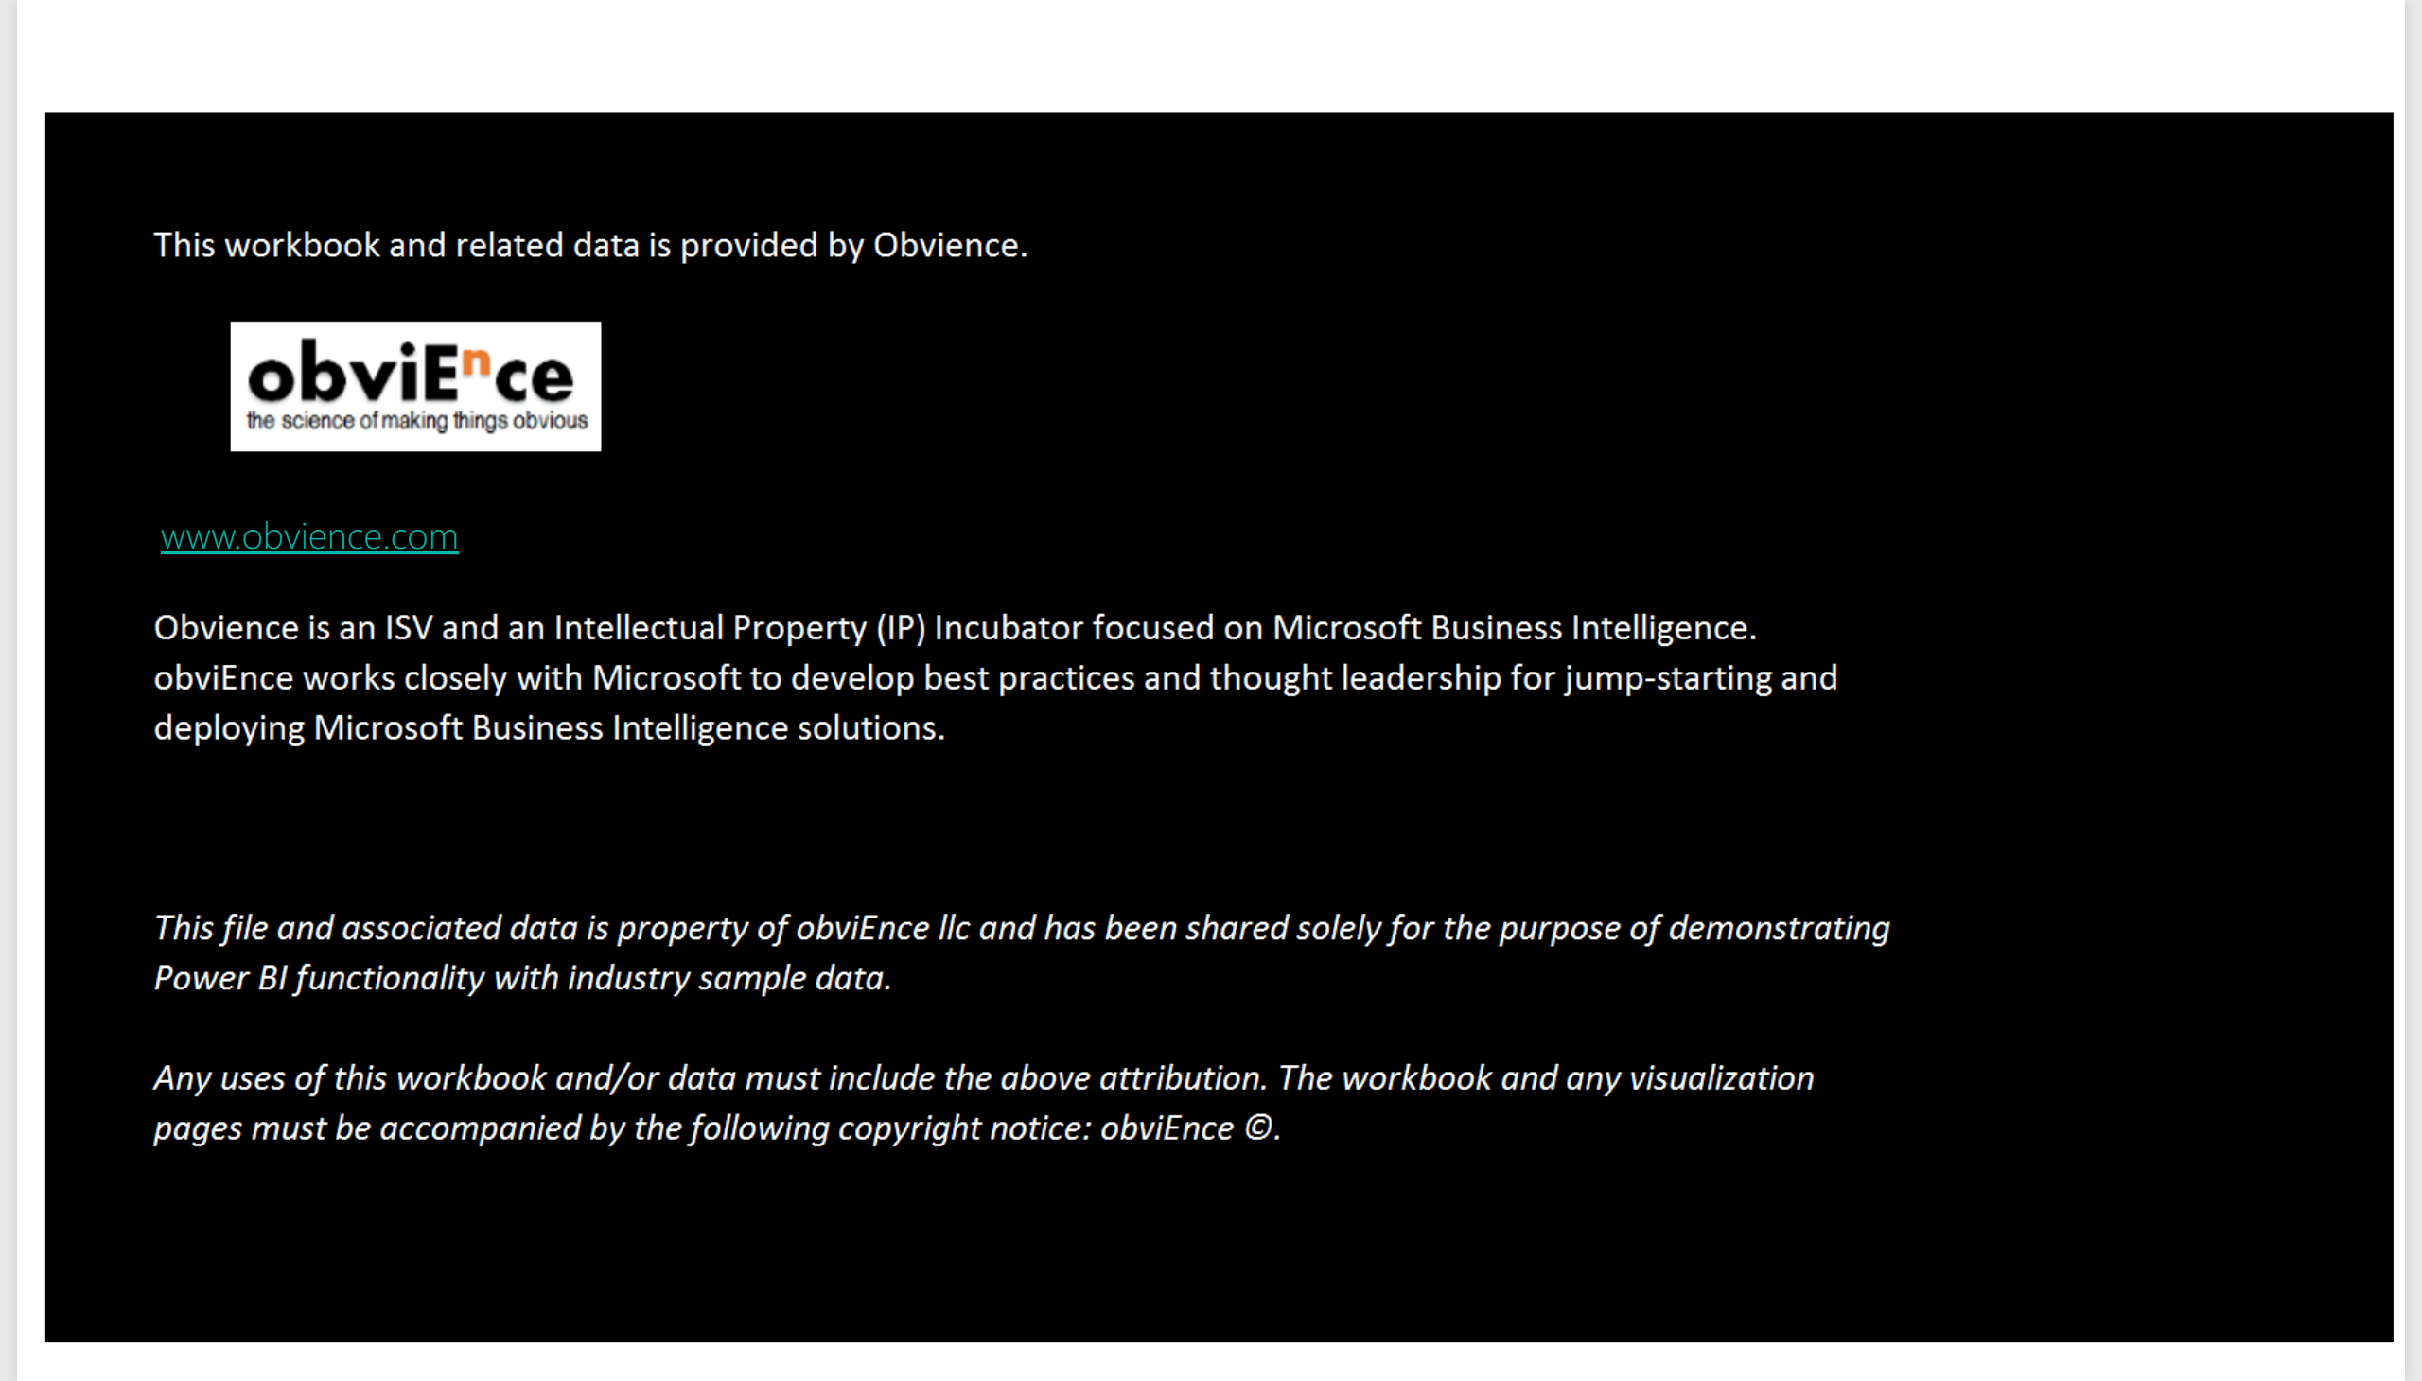
Info
Notes:
image
No alt text provided.
textbox
No alt text provided.

Slide 3
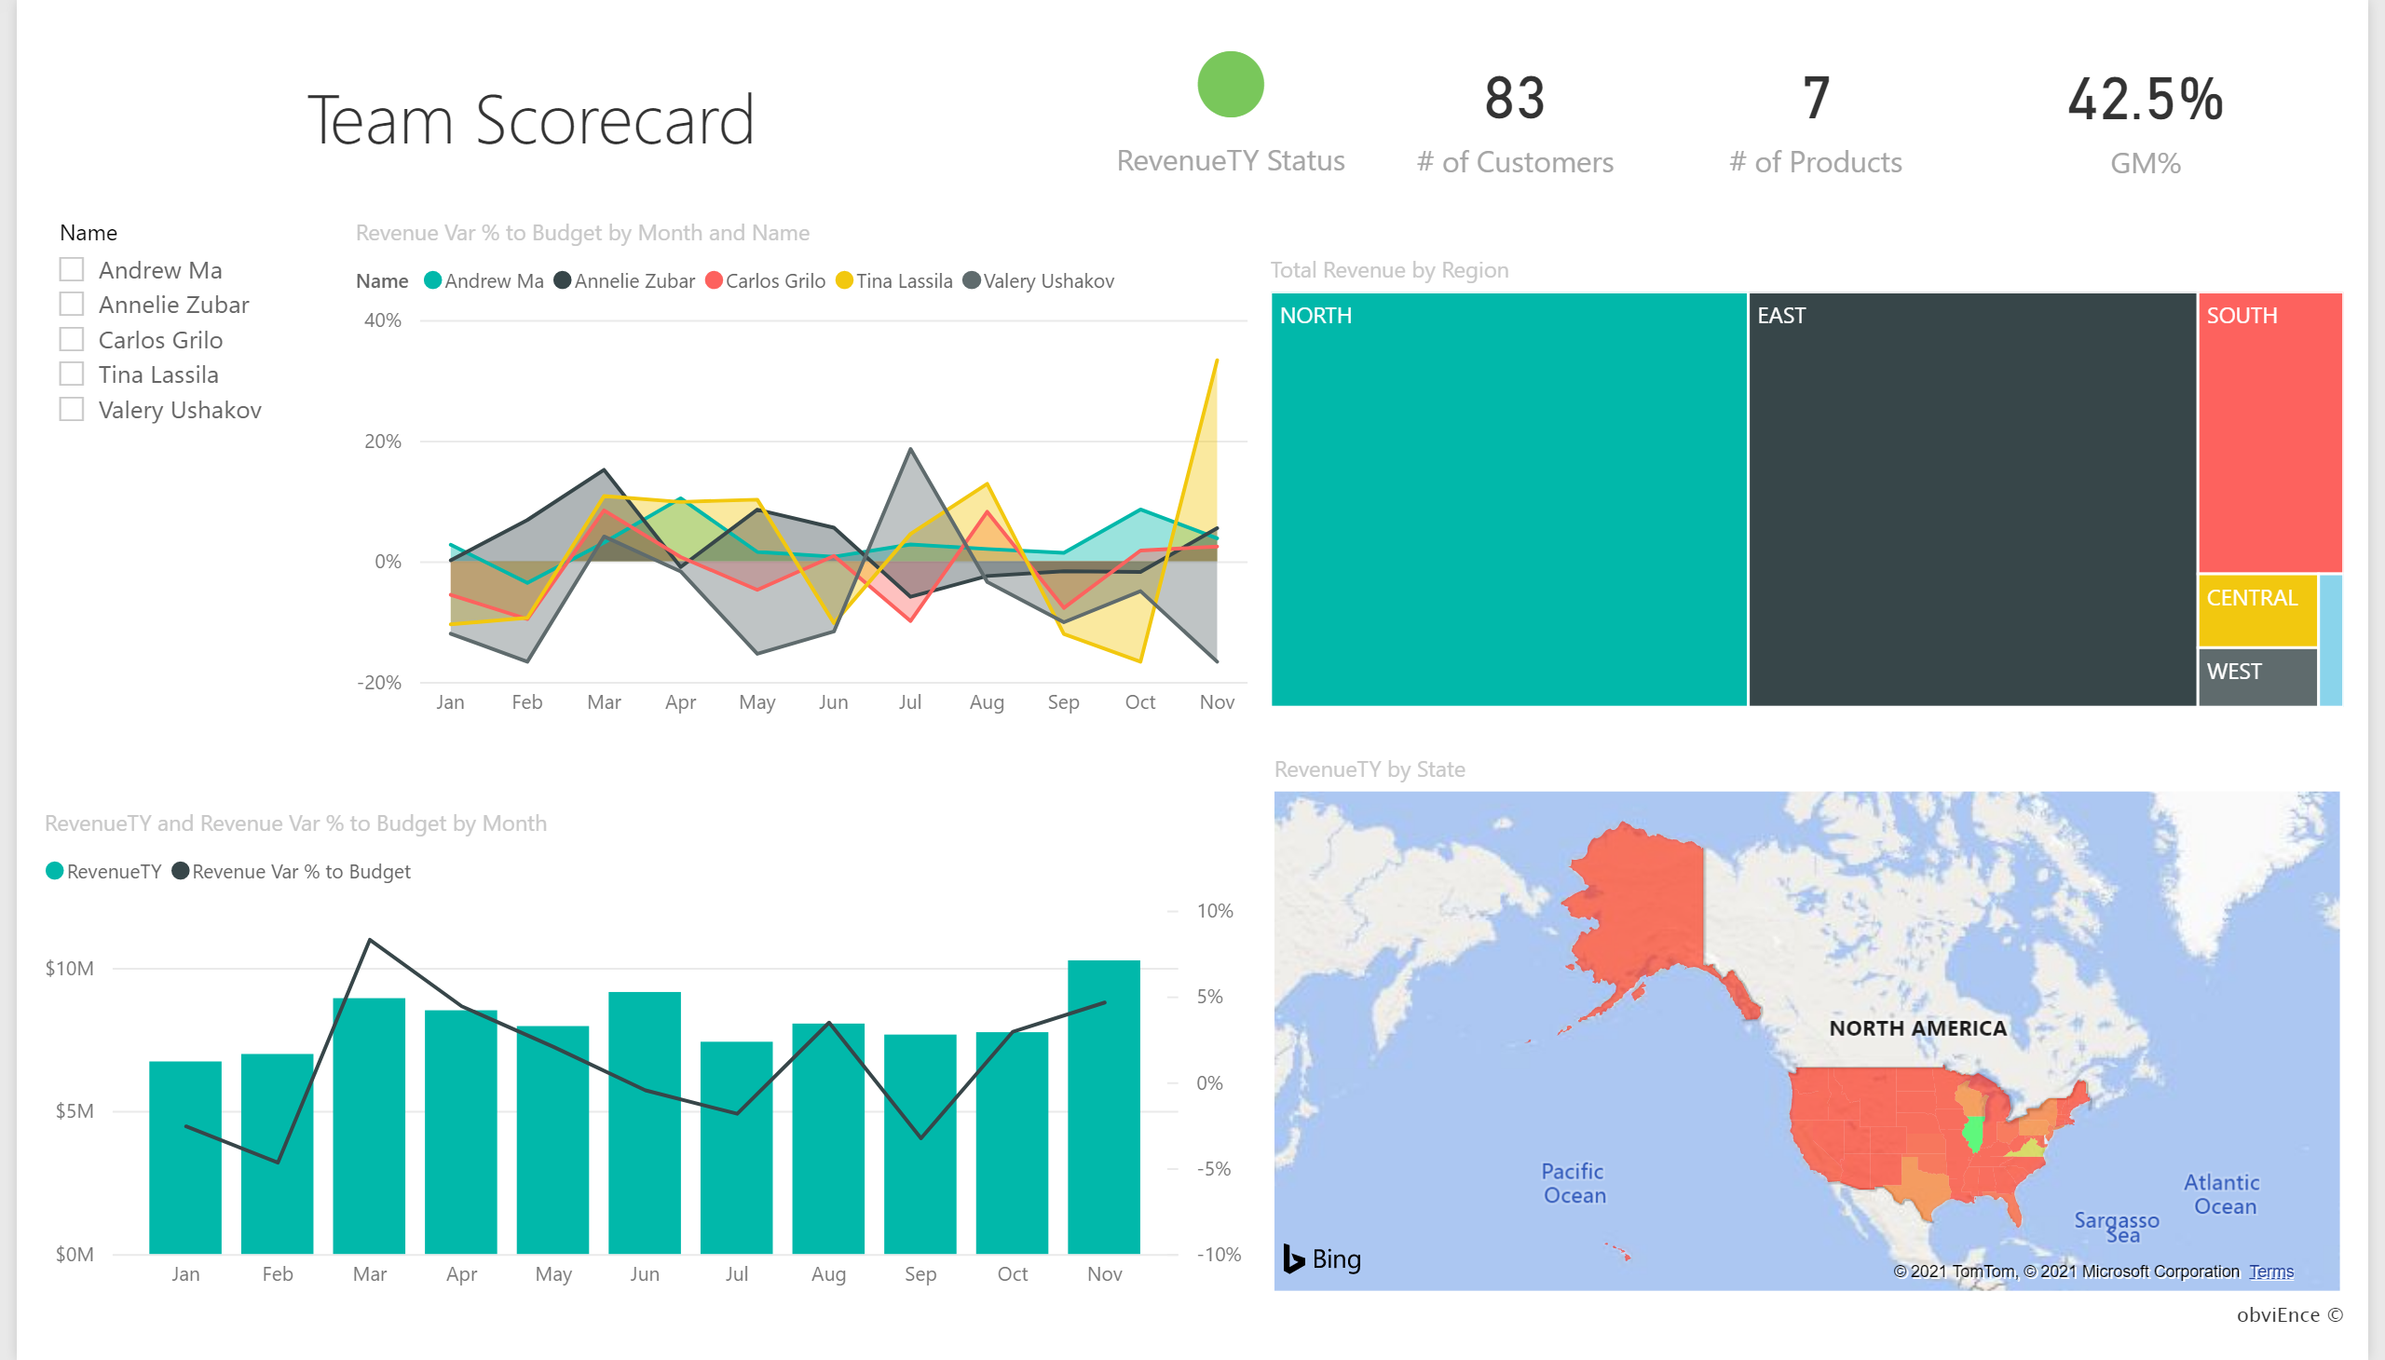
Team Scorecard
Notes:
textbox
No alt text provided.
textbox
No alt text provided.
slicer
No alt text provided.
areaChart
No alt text provided.
treemap
No alt text provided.
card
No alt text provided.
card
No alt text provided.
card
No alt text provided.
card
No alt text provided.
lineStackedColumnComboChart
No alt text provided.
filledMap
No alt text provided.

Slide 4
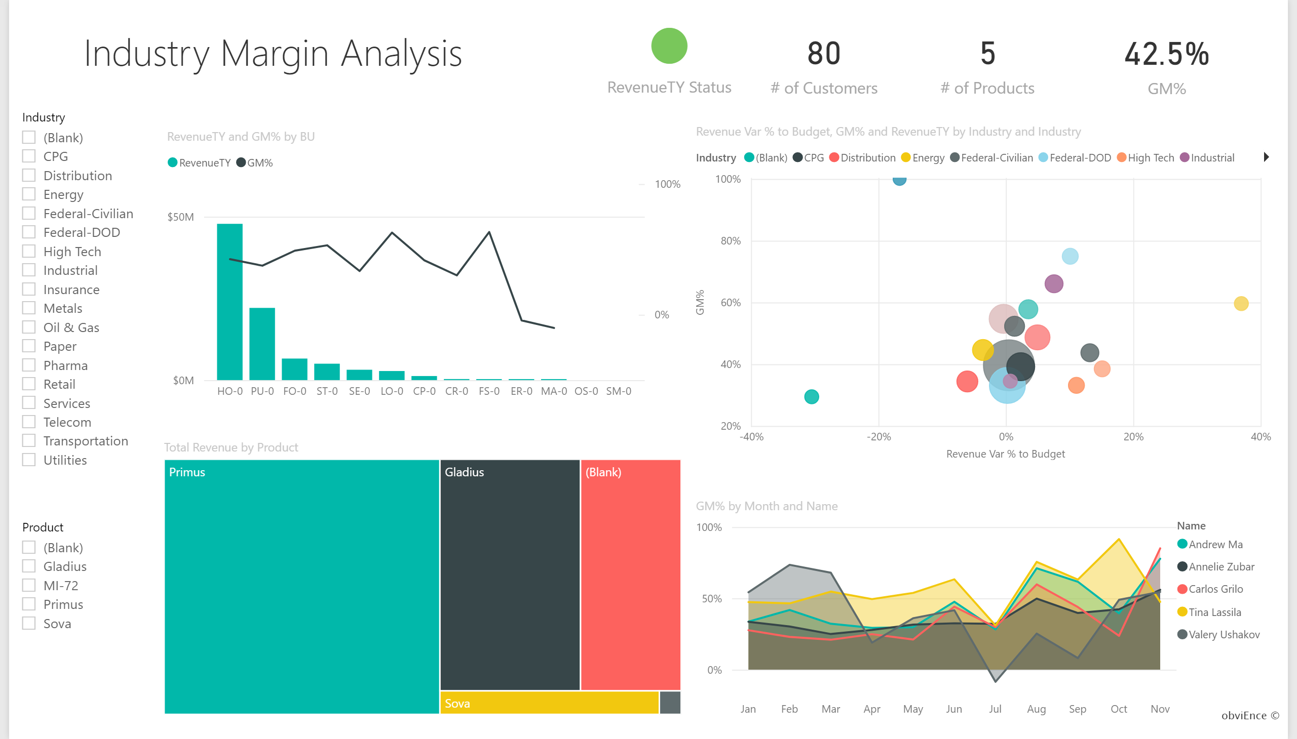
Industry Margin Analysis
Notes:
textbox
No alt text provided.
areaChart
No alt text provided.
textbox
No alt text provided.
slicer
No alt text provided.
slicer
No alt text provided.
treemap
No alt text provided.
card
No alt text provided.
card
No alt text provided.
card
No alt text provided.
card
No alt text provided.
lineClusteredColumnComboChart
No alt text provided.
scatterChart
No alt text provided.

Slide 5
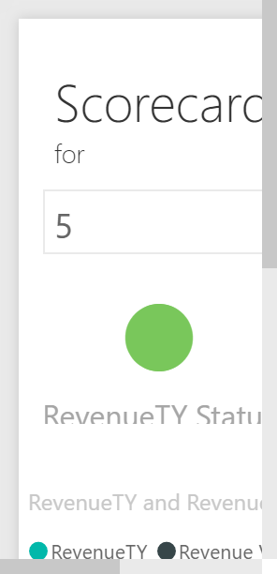
Executive Scorecard
Notes:
textbox
No alt text provided.
slicer
No alt text provided.
card
No alt text provided.
card
No alt text provided.
lineStackedColumnComboChart
No alt text provided.
treemap
No alt text provided.

